Slide 1
IASP 540 PENETRATION REPORTING

Slide 2
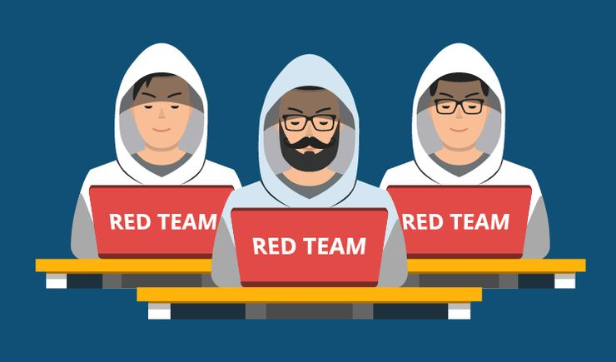
Red Teaming
What is Red Teaming?
Notes:
This Presentation was built under the assumption the organization has already developed a red team
And has gone through the phases of creating the team, assigning roles determining terminology, Developed the TTPs for engagement, Developed data collection guides and tools, develop operational process plan, develop comm plan develop Rules of engagement, tech briefing and report template
Red Teaming is the process of using Tactics, Techniques, and Procedures (TTPs) to emulate a real-world threat with the goals of training and measuring the effectiveness of the people, processes, and technology used to defend an environment.
Red teaming is NOT a hunt for vulnerabilities, flaws, bugs, etc. The goal is to understand security operations as a whole (people, processes, and technology). The result of a red team engagement may identify vulnerabilities, but more importantly, red teaming provides an understanding of blue's capability to impact a threat's ability to operate

Slide 3

Importance
Notes:
Red teaming is important because it allows us to:
Measure the effectiveness of the people, processes, and technology used to defend a network. How do you know if blue TTPs are effective?
Train and/or measure Blue Teams ability to impact a threat Blue teams need practice. Better to practice on a helpful threat that a real one
Test and understand specific threats or threat scenarios Red team engagements can be designed to exercise custom scenarios. Scenarios can include zero-days, ransom-ware attacks, or other unique attacks.

Slide 4
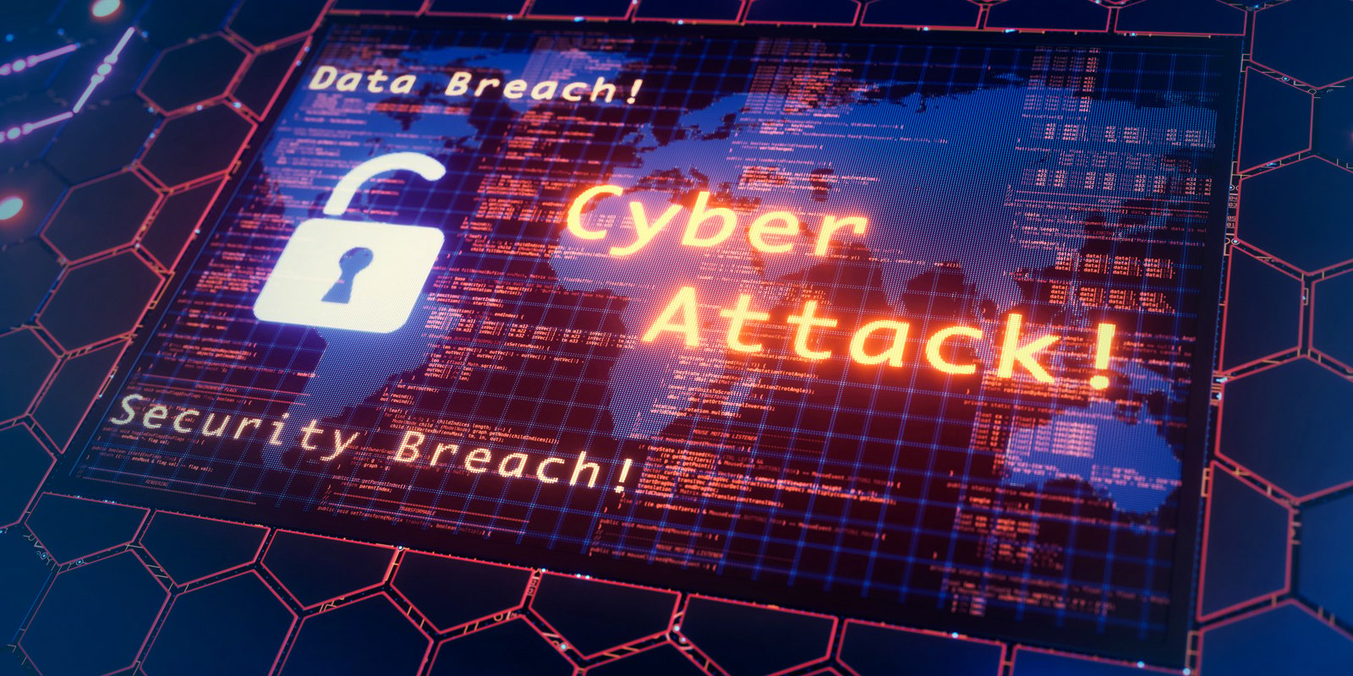
Red Team Threat Emulation
Notes:
Threat Emulation is the red team coming up with a real world scenarios that the organization may experience in order to show the blue team / sys admins where there security is lacking. This will provide the organization with a true security posture output.
These emulations are specific goal driven. These goals could be to gain a specific admin account within the environment through social engineering. But how do we accomplish these goals? We utilize the TTPs
Red team will conduct multiple TTPs and depending on the success or failure of these TTPs it will paint a picture for the organizations security posture. These TTPs will assist the organizations defenders with remediations and will show them how you were able to complete the task.
Now if the TTP was not executed successfully the blue team has done their job and caught the red team. This obviously means that the defenses were in good standing.
Remember that red teams are offensive teams but with the intent / goal to improve the organizations defenses.

Slide 5

Qualifications
Notes:
In order to become a red team member you will need to understand small business large business and enterprise level networks. This means that you will need to understand Networking, Domains, Privilege escalation, Application vulnerabilities, and social Engineering for the start. You are basically going to be an advanced Systems administrator. Red team members are able to gather data quickly in order to get a logical idea of their attack surfaces. Being able to comprehend where firewalls, IPS, and networks switches are placed and being able to bypass proxies to gain access to the companies DMZ is a highly recommended skill to know. GIAC and Comptia have certifications that can back these skills up.

Slide 6
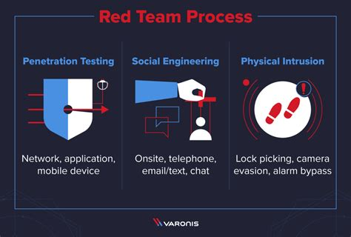
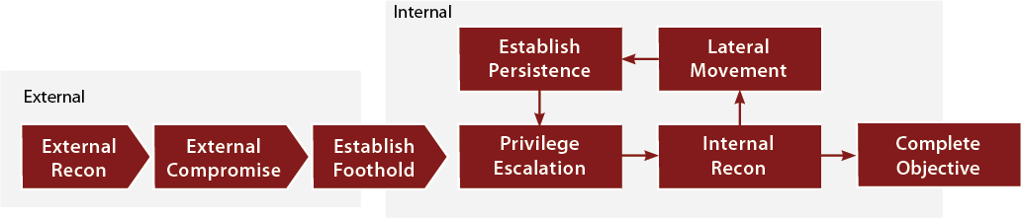
Red Teaming Phases
Planning / Adversary Enumeration
Reconnaissance
Target Identification / Gain Access
Privilege Escalation
Persistence
Lateral Movement
Reporting
Notes:
This is also known as the Kill Chain
Planning / Setting Goals
This is where the red team will come up with their scope of work. An organization will request a red team operation to be conducted. The assessment will then move to this phase of planning. Red teams will include the specific requests of the organization such as specific target packages and what not to target. An example of planning for the assessment would be understanding that they are allowed to prove they can access sensitive information but not withdraw the information. One common method that is requested by organizations to not be performed are social engineering attacks.
This phase is where we would establish our ROE / Rules of Engagements. This is where we would specify the previously stated. We can prove how we can gain access to data but not exfiltrate the data. Through out this planning the team will determine who will do what and how they will accomplish each task. This is where they will pull out their generated TTPs and determine which ones they will use.
For example say the TTP is for exposing a weak application on a web server. The TTP would describe the tactics, techniques, and procedures for how to exploit this weakness. If the organization was using an SEIM application maybe exposing weak SNMP protocols could allow us to connect to the device and from there hop ports.
During this phase there would also be signed agreements between the red team and organization for legal purposes in order to protect the team and the organization.

Slide 7
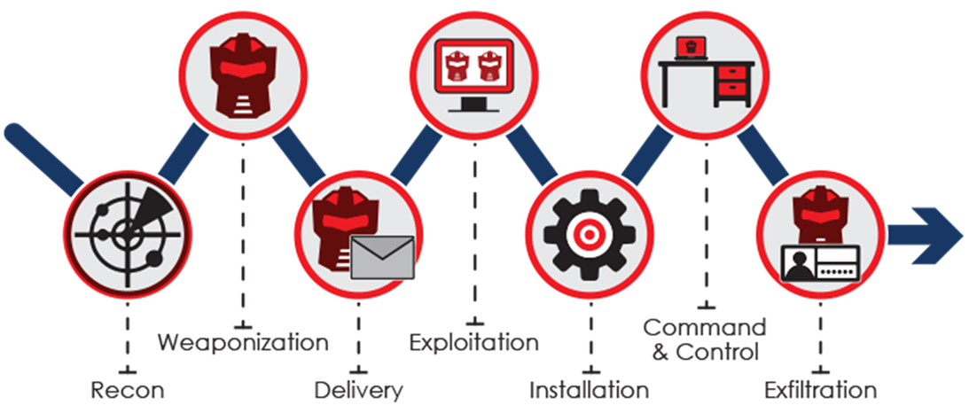
TTP
Red Teams Utilize TTP methodology
Tactics
Techniques
Procedures
Notes:
Tactics
Tactics are dialed in ideas, Strategies, Specific things that can be done to achieve something.
For Example a chess move, or a specific play in a team based sport
Techniques
Techniques are methods and concepts by which something could be achieved.
For Example: Hiding in specific system location, or using redirectors on a C2 server.
Procedures
Procedures are steps and processes by which something is executed.
For example The specific flow by which various tactics and techniques are utilized by a red team

Slide 8
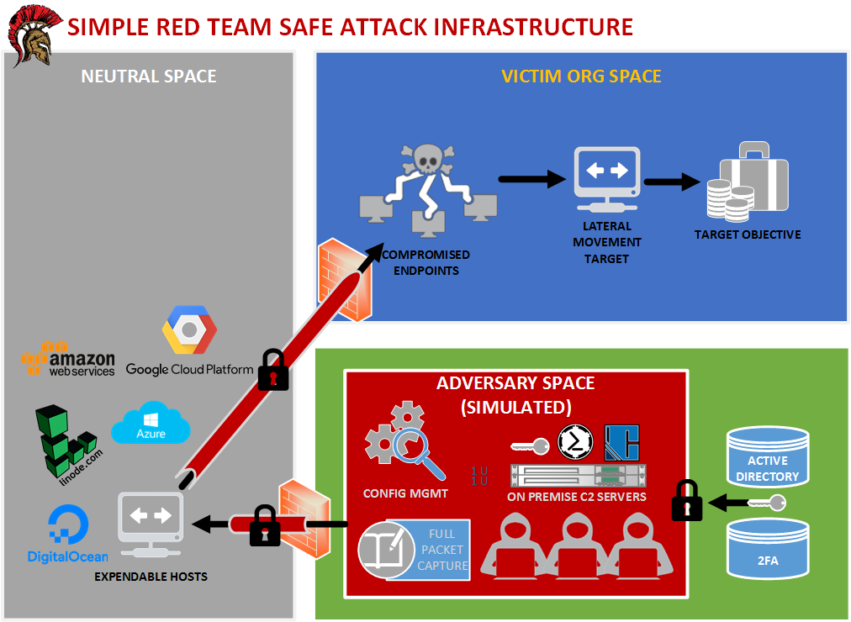
Basics of Command and Control
Known as:
C2
CnC
C&C
Main factor of controlling one or more remote systems across network boundaries
Offensive Security engagement
Notes:
Command and Control is the idea that we can establish a connection with multiple hosts across a network boundary. This will also give us the capability to control those hosts. This is accomplished by already having gained privledged access to the network. This can be refer to as having a shell on your box.
To understand what a C2 server is we need to first understand how a client and server communicate.
In regards to a normal Client whose computer is connected to a layer 3 router and modem connection in their home reaches out to a web page and requests the content. During the request the server opens a port for the client to pass the request through and then the content is pulled from a server running a web host service and sent back to the client in order for the user to view it. Now it is possible for that server to try and contact the client via the ip address that the client has sent over within the request. Unless your client has been configured to allow the servers traffic to be accepted this will fail.
With that all in mind on normal client server communication, we can configure our client to act as a server and reverse the role. The web server now becomes our client in which the client is our target. This gives us the option to connect to the client or make the client connect to us.
We conduct this through a bind which is over port 4444 in order to establish a reverse shell connection. One option to complete this task is to run our C2 implant on the client and the client would open a port for us so we can connect. The direction would be from our server to the client over a bind connection to the target service via our implant. This option will be stopped or interrupted though if the client is behind a firewall or we do not have sufficient privileges to have the client open a port for us.
Another option is for the client to connect to us instead, this is known as a reverse connection over port 4444 as well. This method will allow us to bypass the firewall and have the client connect to our C2 server. In the instance of a reverse connection think of this method as literally flipping the connection roles instead of us the user connecting to the web page and it sending us content, we are now the server aka C2 server sending the web page server now the client, content.
Once the reverse connection has been made the C2 server will have a successful reverse shell interpreter connected to the client. C2 is basically remote administration software, This server will send over inputs to the client where the client will execute those inputs.

Slide 9
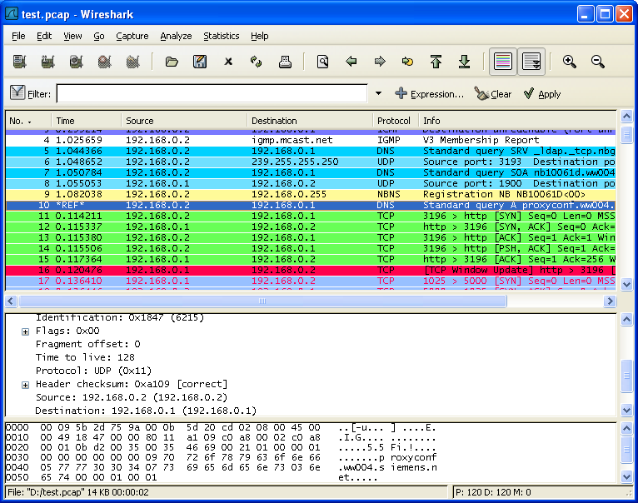
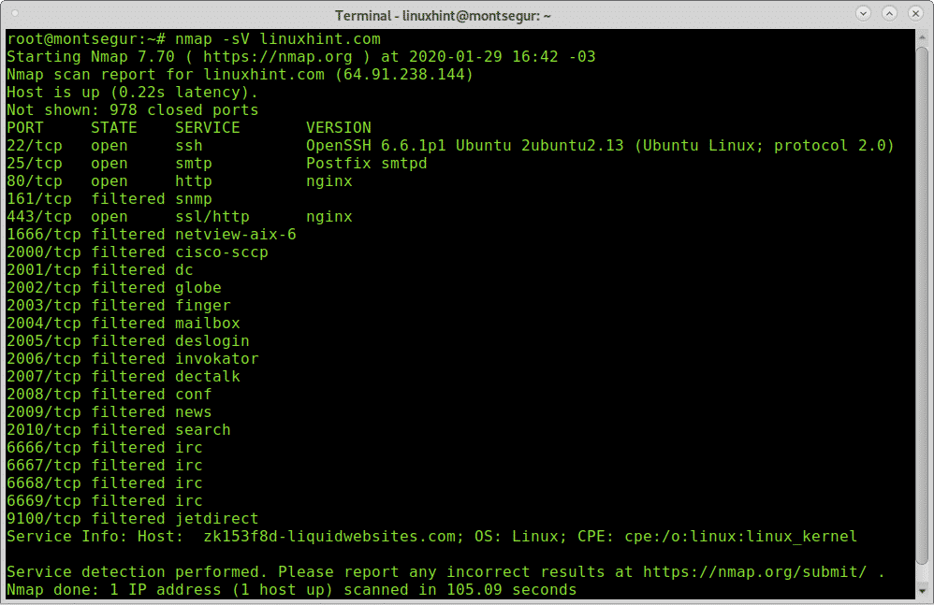
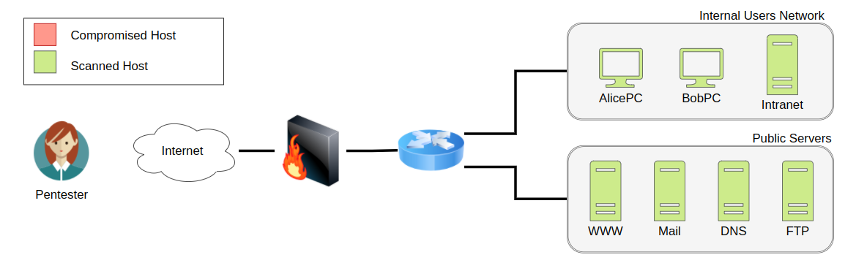
Reconnaissance
Notes:
The reconnaissance phase:
The red team would utilize their C2 server containing the necessary tools to map out the network. This phase will require an understanding of data center architectures and networking. This phase is where we would map out the organizations network to determine where their hosts are placed in what subnets, where their applications might be hosted, where are the phones, email servers, firewalls, IPS, etc.
Our goals during the recon phase would be to actively scan the network, gather target host information, gather target identity, gather target network information, gather target org information, search the closed sources, seach open technical databases, search open websites or domains
Active scanning we can use port scanning vulnerability scans and website directory brute force
Search open tech databases we can use search engines and social networks
Search open website / domains we can use whois information, DNS records, Subdomain enumeration, discover web technonoglies and stacks utilized, identify vulnerabilities
Gather target identity information we can use emails credentials employee names
Some tools we can use are DNSrecon which comes built into kali linux, wafw00f which detects WAFs in front of a website, netcraft site report which tells us the technologies that the site might be using, and whatweb that will tell us what kind of site that target is and can detect account ids, emails, versions, and SQL errors.
If we look at the output of nmap we have the flag –sV requesting ports and services from linuxhint.com this gives us an idea of what ports are open on this particular web host. Using nmap we can gain more granular information on the web host or more of a topology of the network. We can scan a whole subnet of the known web host to determine other sub domains.
Through nmap we can also identify vulnerabilities of a firewall utilizing the nmap –sV <ipaddress> command. This will provide us with information about the firewall, open ports, and version.
Class try and complete the syntax for an nmap stealth scan
sudo nmap -sS -A -T4 -p- <TARGET-IP> -oN output.txt

Slide 10

Target Identification
Selection of target
Team decision
Notes:
During the target identification phase the team will decide on the targets they will begin to gain access to. These selected targets will fall in conjunction with the organizations request for the assessment. For example the organization may give an IP range of what they can attack and recon but anything outside that range is off limits.
We will use all the information gathered from the recon phase to create target packages that are deemed susceptible to an attack.
The target in most organizations would be application hosts switches with outdated firmware, unpatched email servers

Slide 11
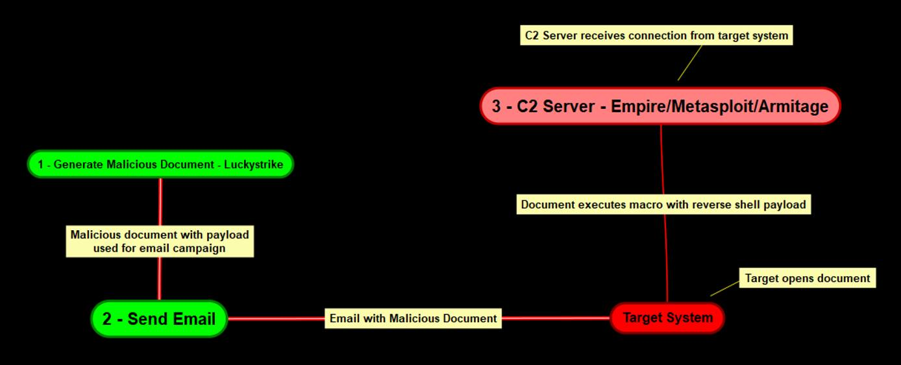
Gaining Access
Notes:
Gaining access to servers will be the required in order to ensure true exploitation. The techniques and tools that will be used for gaining access will be laid out in the TTPs that were generated. These contain the procedures for executing these specific tasks.
Some techniques to gain initial access would be Phishing, Exploit Public facing application, Replication through removable media, supply chain compromise, external remote services.
Walkthrough of attack method
The attack methodology can be broken down into the following procedures:
Setup C2 server with Powershell Empire - C2 (Command and control) servers are used by attackers and adversaries to maintain communications with compromised systems on the target network.
Generate stager with Powershell Empire - A stager is used to establish a communication channel between the attacker and the victim.
Inject the payload into a document as a macro with Luckystrike.
Send the document to the target system via email.
Target opens the document and consequently runs the malicious macro.
Stager connects back to the empire listener.

Slide 12
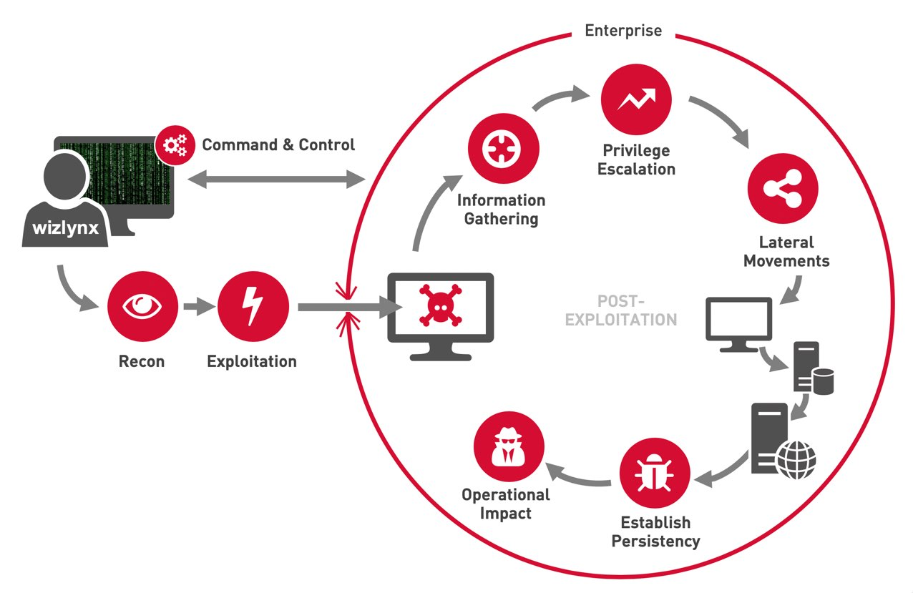
Persistence
Account Manipulation
Autostart Execution
Initialization scripts
Create local account
Notes:
Through the persistence phase we can establish our foothold within the network. We can accomplish persistence utilizing a few different technologies. But the basis of the goal here is to maintain our connection for future use.
We can utilize PowerShell Empire with persistent modules
-Userland: reboot persistence non elevated
-elevated persistence: Reboot persistence elevated
-Power Breach: In memory powershell backdoors
We can also use Persistence through Windows Registry. Utilizing the userland modules in Powershell Empire, The triggers for userland are storred in different locations through out the registry keys in windows.
We can also setup persistence through the windows scheduled tasks. We can have userland execute on specific times by creating a tasks mapped to the storage location of the trigger within the registry keys
Last way we can keep persistence is through making a local account in order to continuously gain access to the server

Slide 13
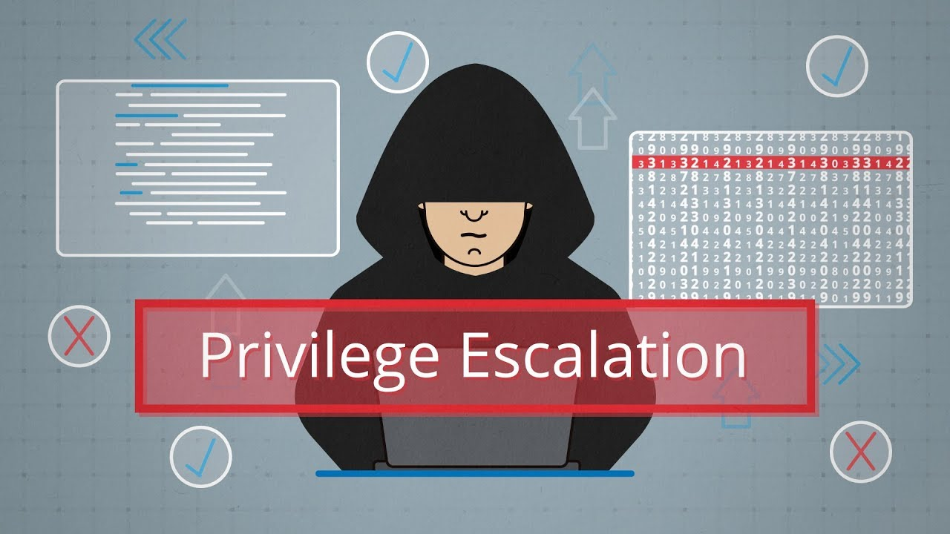
Privilege Escalation
Elevation control Mechanism
Access Token Manipulation
Exploitation for Privilege Escalation
Notes:
Privilege escalation is just how this sounds. We are attempting to gain access to an admin level account in order to gain a deeper foothold, this will allows us to gain even more persistence within the environment. There are a few tools to use in order to gain an admin account:
Bypassing UAC - Adversaries may bypass UAC mechanisms to elevate process privileges on the system. Windows User Account Control (UAC) allows a program to elevate its privileges (tracked as integrity levels ranging from low to high) to perform a task under administrator-level permissions, possibly by prompting the user for confirmation.
Kernel Exploits - Adversaries may exploit software vulnerabilities in an attempt to elevate privileges. The exploitation of a software vulnerability occurs when an adversary takes advantage of a programming error in a program, service, or within the operating system software or the kernel itself to execute adversary-controlled code.
Token Impersonation - Adversaries may duplicate then impersonate another user’s token to escalate privileges and bypass access controls. An adversary can create a new access token that duplicates an existing token using DuplicateToken(Ex). The token can then be used with ImpersonateLoggedOnUser to allow the calling thread to impersonate a logged-on user’s security context.

Slide 14

Reporting
Provide detailed information on attack surface
Provide flags captured
Layout remediations and recommendations
Notes:
This is an important phase for the red team. The whole point of them conducting an assessment is to report back to the customer with all the findings. This document should thorough and well detailed. It should discuss the scope of work and how each flag was captured utilizing what TTP.
The official red team report should be structured in a particular way. This is an official document to the organization so specific letterheads should correlate.
The document will contain:
Executive summary which will contain a summary of the results. It will describe the companies requests and inputs including the overall results of the assessment.
Attack narrative: This will discuss the methods of recon, target ID, gaining access, persistence and privilege escalation. This section will be detailed and contain the tools and outputs of each phase.
Conclusion will include recommendations and risk rating
These reports may also include an appendix section for Vulnerability details and mitigation procedures.
Show example of offensive security report.

Slide 15
Project
Create a Cybersecurity company
You have just completed your first assessment of Company A
Create a Final Assessment report utilize all technology at your disposal
20 Pages
Sections should include
Executive Summary
Attack Narrative
4 – 5 narratives w / output images (find on internet)
Conclusion
Appendix Vulnerability Detail and mitigation
2 – 3 vulnerabilities with mitigations
DUE LAST DAY OF CLASS
Notes:
This will be the end of the year project. You will create an assessment report from your fake red team company. You will be assessing Company A or change the name. Create a full assessment using any means of information, Internet books whatever. This is all imaginary so use your creativity and think like a hacker when coming up with these attack narratives. The report should be 20 pages long as this should be fairly easy to accomplish because you will be including images and network diagrams found on the internet that you can use You can also make your own if you would like! I would like to see 4 – 5 attack narratives with output images. The report should include a conclusion that discusses recommendations to company A and their Risk rating. At the end should be an appendix that discusses the vulnerabilities that were found in the company and recommended Mitigations. This will be due at the end of the semester.

